Slide 1

Proxy Access
Architecture Strawman
June 2021

Slide 2
1 Introduction
A way to consistently and securely give trusted individuals the right to access NHS services on behalf of the patient
It will provide a standard, digitised, approach to proxy management, owned and controlled by the user, so that we can empower patients to monitor and manage their own health and care needs in the way that best works for them
Proxy access is about establishing trust between people, care professionals and organisations.

Slide 3

2 Background
Discovery research has been conducted by NHS Digital into the adult-to-adult and adults with Parental Responsibility user scenarios.
Policy and IG development has been conducted across all user scenarios and is ongoing.
An approach is being developed for the service as a whole which aims to create a personal electronic ‘wallet’ which will store a person’s credentials, giving them authorised access to specific health information. In this way the information is decentralized and owned by the individual and the format is modularised; with the ability to add services and proxies over time
This approach is similar to that used in the currently live ‘Digital Staff Passport’ service, and will build on that knowledge and understanding.

Slide 4
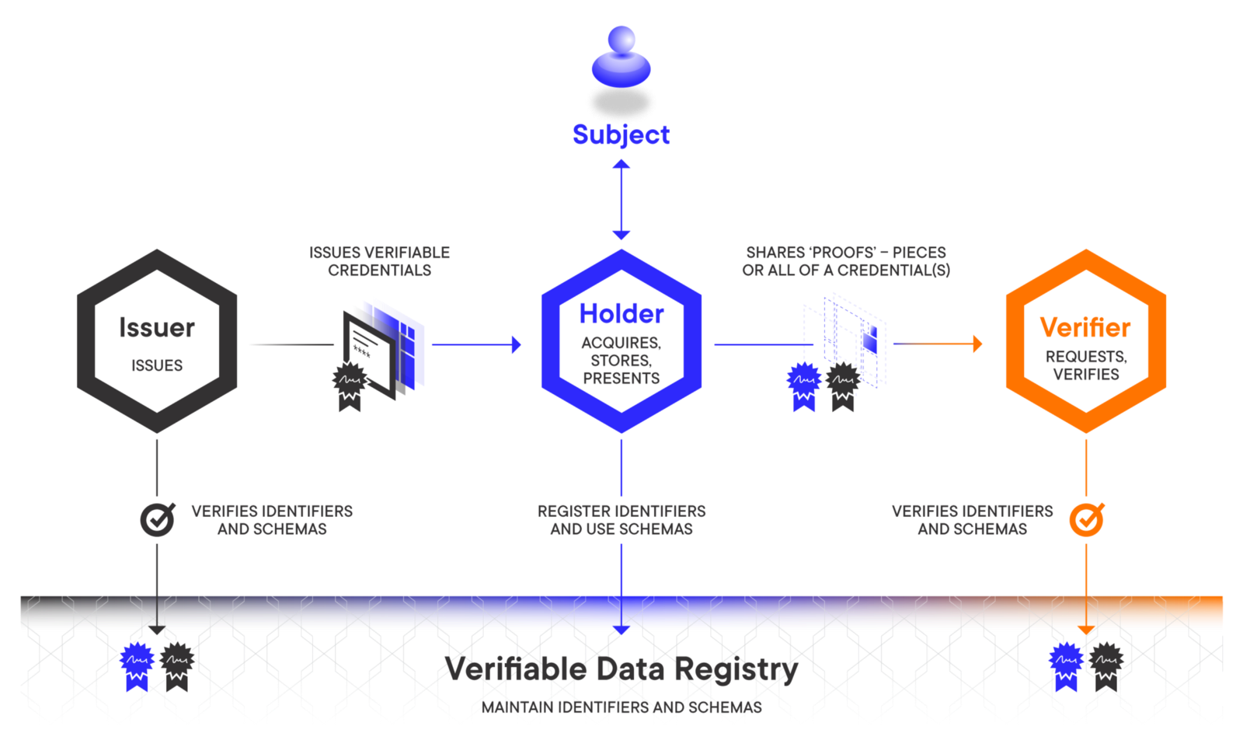
3 Verifiable Credentials Approach
Certified ‘issuers’ verify a person’s credentials which are then held by an individual in their personal store. When required these credentials are verified and the holder given access to the information required

Slide 5
4 Participants
Issuers
Typically an authority that creates a claim and associates it with a subject (typically a person). The issuer’s key functions are to issue, assert, revoke or amend credentials.
Issuers can issue credentials that support selective disclosure
Questions: How do we initiate the process securely when neither party is aware of the other (use of QRCode etc), how do we revoke a credential and how will this be communicated back or should it under circumstances such as fraud, safeguarding concerns etc.
Holders
Holders store credentials in credential repositories. Verified credentials can be stored directly in the user wallet or in the holder (agent/custodian) cloud wallet.
Holders interact with Verifiers and Issuers through user agents (software services)
Questions: How will the holder of a verifiable credential restrict the amount of information exposed in a credential it chooses to share, how do we limit the duration for which that information is shared, how does the holder manage these agreements?
Verifiers
Typically a service provider that verifies a claim about a given subject. The verifying entity must have the capability to connect the issuer’s identity to its credential identifier and the subject’s identity to its identifier as indicated in the credential.
Verification should not require direct interaction between verifiers and issuers
Questions: How is the issuer’s verification information, such as its public key, made discoverable, how are access control policies managed

Slide 6
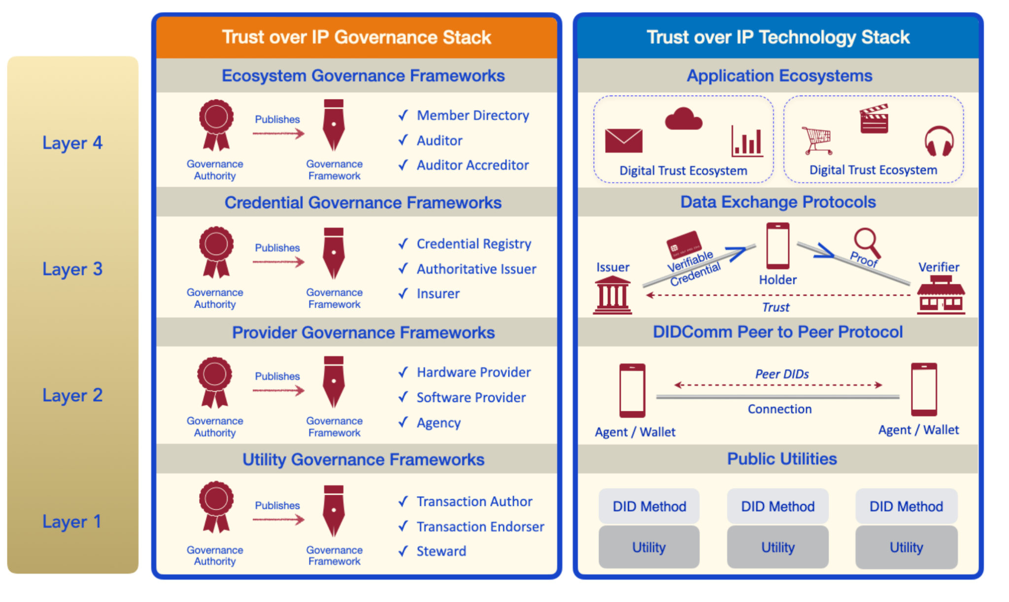
5 Trust Over IP Dual Stack
The Trust Over IP stack defines a standard information network architecture that developers can implement to establish trusted relationships over digital communications networks.
The ToIP stack does not define specific governance frameworks. Rather it is a metamodel for how to design and implement digital governance frameworks that can be universally referenced, understood, and consumed in order to facilitate transitive trust online.
The Trust Over IP Stack

Slide 7
5.1 Layer 1 - Public Utilities for Decentralised IDentifiers (DIDs)
The ToIP stack is made possible by new advancements in cryptography and distributed systems, including blockchains and distributed ledgers. Their high availability and cryptographic verifiability enable strong roots of trust that are decentralised so they will not serve as single points of failure.
A Layer One public utility may choose any governance model suited to the the constraints of its business model, legal model, and technical architecture. This is true whether the public utility is operated as a blockchain, distributed ledger, or decentralised file store, or whether it is permissioned, permissionless, or any hybrid. (Note that even permissionless blockchain networks still have rules—formal or informal—governing who can update the code.)
Utility governance frameworks that conform to the ToIP Governance Stack model will support standard roles for all types of utility governance authorities. For example, the role currently supported by public-permissioned utilities such as those based on Hyperledger Indy include:
Transaction Authors: initiate transactions
Transaction Endorsers: permission transactions for Transaction Authors
Stewards: operate a node of the ledger
The Trust Over IP Stack

Slide 8
Decentralized Identity Concepts explained
Identity Ownership: Users create and hold identities (in their digital wallets) rather than having their data in the control of any website or application.
Data Ownership: Identities create and control personal data stores with access delegated only to the services that need it.
Secure Cryptography: Identities are created with a unique public and private keypair that is used for encryption, signing, and making relationships with other parties.
Peer-To-Peer Relationships: Identities can be used to form unique cryptographic relationships with other entities (e.g. other users, web sites). This provides the foundations for end-to-end encrypted communication, authentication and so on.
Edge and Cloud Agents: Software components are available to help manage the decentralized identities, including setting up relationships and handling communications.
Verifiable Credentials: Identities can make assertions which are cryptographically verifiable by the receiving party.
Zero Knowledge Proofs (ZKP): As part of the verifiable credential system, ZKPs enable identities to make assertions about data without revealing the data itself.
https://anonyome.com/2020/06/decentralized-identity-key-concepts-explained/

Slide 9
Identity ownership
Under a decentralized model, users create their own identity using their local identity creation tools (such as provided by a digital wallet app). The new identity resides in the user’s local wallet, which remains securely on the user’s own devices. This model enables the user to take their identity with them wherever they go and transfer (or replicate) it to any of their own devices. Since the identity remains within the user’s control, it can’t be deleted (purposefully or inadvertently) by a remote application or compromised if a remote website gets breached.

Slide 10
Data ownership
In addition to ownership over the identity itself, decentralized identity provides complete ownership over user data via personal datastores, called identity hubs. Each identity can have one or more identity hub that can store data for one or more services. The key difference between storing data with a specific service via their platform and storing it in an identity hub is that the user retains full ownership of the data, including who can access it. If the user decides to discontinue using the service, or move to a different one, they retain full control over their data.

Slide 11
Secure Cryptography
Each identity will contain a decentralized identifier (DID) and a unique private/public encryption pair. DIDs are created as Uniform Resource Identifiers (URIs) and reference individual identities similarly to how URLs form references to web pages.
The format of a DID starts with a scheme that defines the URI as a DID. The DID Method is a service location where the DID is hosted and resolved, such as the name sov, which resolves at the Sovrin Network. Other users can obtain public information and verify assertions via the DID Method. The DID Specific Method String is a unique value, within the DID Method, for a given user’s identity. What makes DIDs useful is that they are self-certifying identifiers (users can verify that the link is real) and they can return a companion DID Document (also called a DID Doc) that contains additional information, such as their cloud agent’s address, encryption keys, digital signatures, pointers to additional information, etc.
Users may also publish their identity publicly by writing their DID to a distributed ledger or blockchain. The distributed ledger serves as a trusted, decentralized public key infrastructure. By leveraging the ledger, users can create connections that can be verified by any other user or entity by querying the ledger.

Slide 12
Peer-To-Peer Relationships
One of the clear advantages of decentralized models over current models is that decentralized identity users negotiate peer relationships with the users or applications with which they connect. In traditional identity models, a username and password (or its hash) is often sent to a remote application when authenticating a user. Conversely, in decentralized identity models, the identity owner and the remote application securely exchange unique DIDs when creating a new peer relationship. These relationship specific DIDs are known as pairwise DIDs and are kept only with the negotiating parties (i.e., are never posted to a public ledger) for use during their encrypted operations. Since the pairwise DIDs are privately negotiated only between the two parties, no external public key server, host messaging server, etc. has access to the keys or plaintext messages and strong end-to-end encryption is achieved.
With peer relationships, either party can choose to terminate the relationship at any time and doing so does not delete the identity. Conversely, under centralized and federated models, a user’s identities exist at the behest of the owning applications and can even be deleted by the owning application. In fact, if every centralized or federated application decided to delete a user’s identity, then that user would effectively cease to exist, at least online.
One significant benefit to users is that pairwise DIDs enable them to identify remote users and establish fully end-to-end encrypted communications with them by using the capabilities of their decentralized identity-enabled apps, while keeping the private encryption keys safely within their own devices. The benefit of this standardized encrypted communications can be understood by examining the current encrypted messaging space. Applications such as WhatsApp, Signal, Wire and MySudo all have end to end encrypted communications. However, they only work within their own system (i.e., Signal app to Signal app), and encrypted communications are not currently possible between separately hosted applications (i.e., Signal app to MySudo app). Communications using DIDs and DID-based communication protocols, can bridge end-to-end encrypted communications between separate walled gardens.

Slide 13
Edge and Cloud Agents
Users can install applications and subscribe to digital identity services for a wide range of purposes. Digital identity apps that provide local functionality and services (e.g., decentralized identity wallet) provide what is called an edge agent. Digital identity owners can also employ a cloud agent to help them with cloud-based activities. For example, a cloud agent can receive messages sent from remote peers and store them until an identity owner’s edge agent (e.g., device, app, etc.) connects to the cloud and is ready to receive them.
Both edge and cloud agents abstract the complexity of strong cryptographic services and simplify decentralized identity operations, so that users can invoke very complex operations with a simple button press, such as: ‘Create digital wallet’ or ‘Create identity’. This simplification matches the complexity tolerance threshold of the average internet user and results in apps that users will actually use.
Using edge agents, users become better equipped to easily and unobtrusively manage their identities, public keys, enter into end-to-end encrypted communications with other parties, etc. Similarly, cloud agents enable users to carry out cloud-based operations (e.g., receiving messages) without needing their personal devices to be continuously online.

Slide 14
Verifiable credentials
Verifiable credentials are a standardized method for issuing and presenting claims about a person’s identity (e.g., driver’s license, university qualifications, passport, gym membership, etc.). An owner of a verifiable credential can create assertions about those claims (e.g., ‘I graduated’, ‘I’m over 21’, ‘I paid my fees’, etc.) and present those assertions to other parties who can then verify them using decentralized identity cryptographic methods.
Using this process, users can convey trusted and validated information to requesting parties who can validate the information’s authenticity. The potential use cases for verifiable credentials are virtually unlimited and can support high value credentials, such as government IDs, digital university diplomas, etc. Additionally, using verifiable credentials can simplify everyday authentication scenarios like website logins, in app credits, social media post authorship, etc.

Slide 15
Zero Knowledge Proofs
Another major cryptographic element used by decentralized identities requesting and validating verifiable credential assertions is known as a zero knowledge proof (ZKP). The purpose of ZKPs is to enable two parties to make and validate assertions about a data item without having to disclose the data item itself.
Under centralized or federated architectures, a user can instruct their service operator to provide assertions to other parties. One example is when users provide their birthdate to a host operator who may unlock select information for permitted users. Some of the downsides to this method include users providing a false birthdate or attacks that disclose personal data to hackers. Both site operators and users are left simply hoping that information remains accurate and secure.
Using ZKPs, users (possessing issued verifiable credentials) may assert relevant facts about themselves without having to divulge their actual personal data. For example, using ZKPs a user may receive a national identity credential from a governmental agency, which would contain their birthdate. To participate in some services (e.g., social media accounts), users must prove that they are above a certain age (e.g., age 13 for Facebook). The user could then present the service with verifiable proof that they are above a certain age using the credential from the government agency. The service knows that the user is above a certain age and that this information is provided by a trusted credential, but never knows the specific birthdate of the user. This helps to protect the privacy of the user and protects against the leak of personally identifying information since the birthdate was never provided.

Slide 16
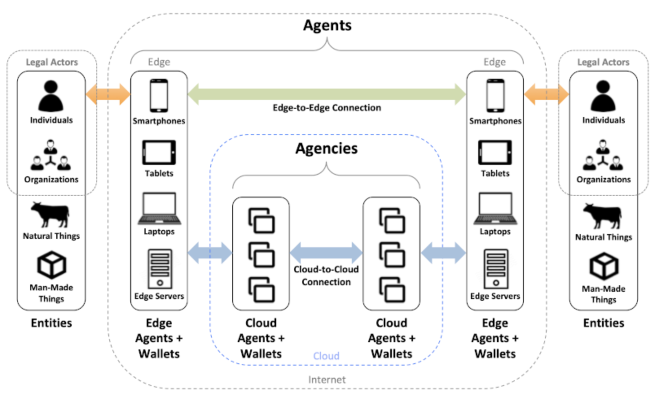
5.2 Layer 2 - The DIDComm Protocol
The second layer of the Trust over IP stack is defined by the DIDComm secure messaging standards. This family of specifications, which are now being defined in the DIDComm Working Group at the Decentralized Identity Foundation, establish a cryptographic means by which any two software agents (peers) can securely communicate either directly edge-to-edge or via intermediate cloud agents
The purpose of Layer Two is to enable peers to form secure DID-to-DID connections so they can:
Issue, exchange, and verify credentials over these connections using the data exchange protocols at Layer Three.
Access the Layer One cryptographic data structures needed to issue and verify Layer Three credentials regardless of the public utility used by the issuer.
Migrate and port ToIP data between agents, wallets, and secure data stores without restriction. This data portability is critical to the broad adoption and interoperability of ToIP.
The Trust Over IP Stack

Slide 17
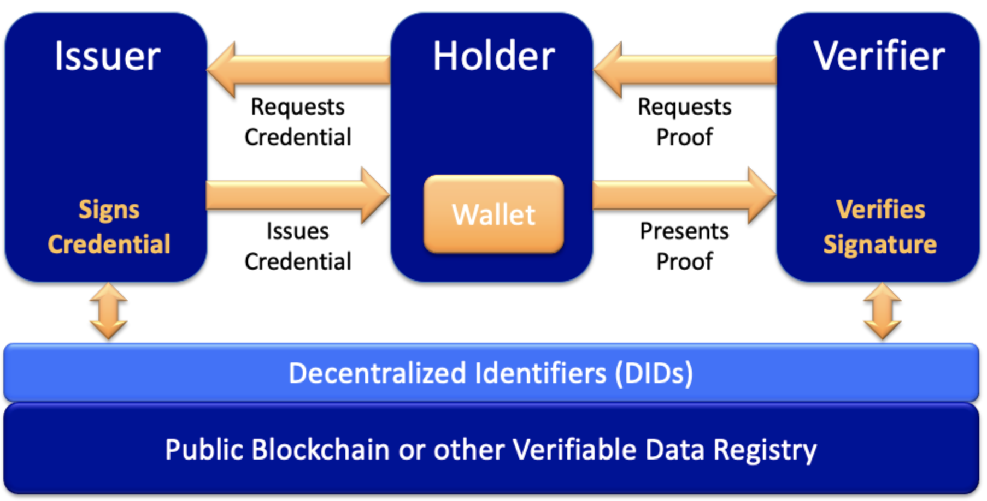
5.3 Layer 3 - Data Exchange Protocols
Layer One and Layer Two together enable the establishment of cryptographic trust (also called technical trust) between peers. By contrast, the purpose of Layers Three and Four is to establish human trust between peers—trust between real-world individuals and organizations and the things with which they interact (devices, sensors, appliances, vehicles, buildings, etc.)
Part of the power of the DIDComm protocol at Layer Two is that it lays the foundation for secure, private agent-to-agent connections that can now "speak" any number of data exchange protocols. From the standpoint of the ToIP stack, the most important of these are protocols that support the exchange of verifiable credentials.
The Trust Over IP Stack

Slide 18
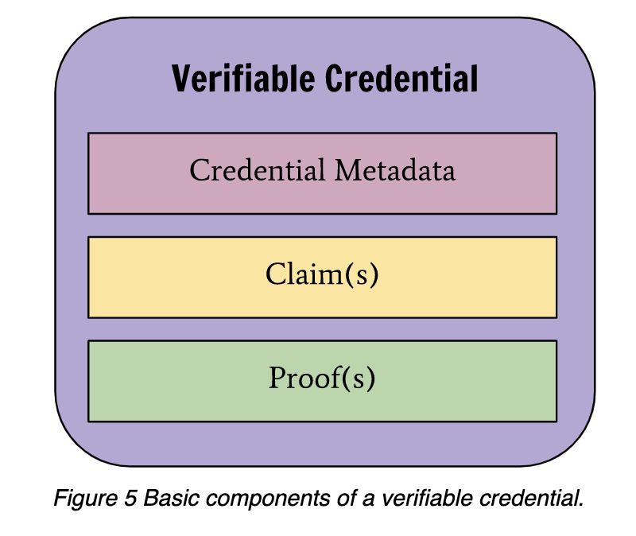
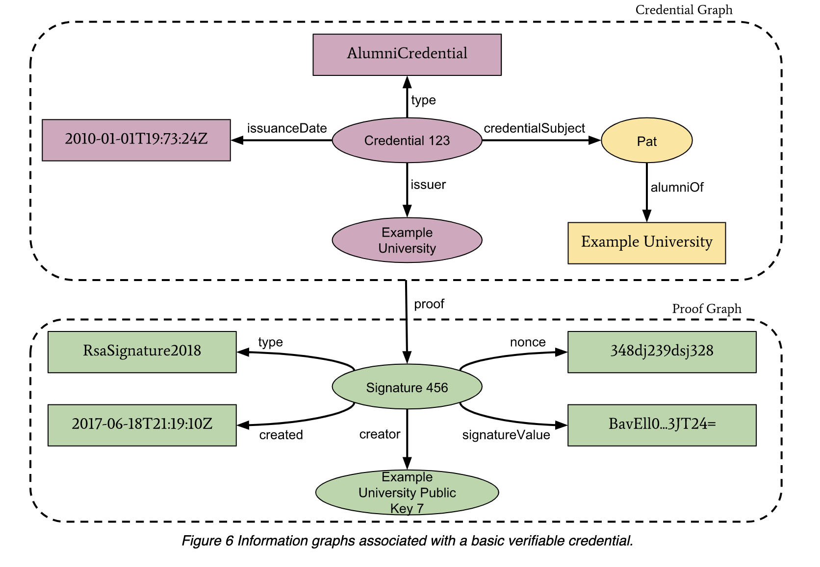
5.4 Verifiable Credentials
Verifiable credentials exchange (VCE) protocols implement trusted data exchange between different parties in a business process and therefore are the most important use case of decentralised identity. A claim is a statement about an entity (subject). Individual claims can be merged to express a graph of information about a subject. A credential is a set of claims made by the same subject. World Wide Web Consortium (W3C) draft specifications define a verifiable claim (or credential) as a qualification, achievement or piece of information about an entity’s background.
Examples are name, age, government identification, address, educational degree, professional certificate and license. Such a claim (or credential) describes a quality or property of an entity that establishes its existence and uniqueness.
Decentralised identity enables VCE by providing discoverable pairwise unique identifiers for each relationship (with different cryptographic key pairs for each identifier). Therefore, relationships are not transitive (i.e., each relationship represents a unique consensual data exchange). This follows privacy-by-design principles by preventing correlation between identity data associated with different relationships. It also provides the identity trust fabric (ITF) as a trusted medium to store DID documents, standardised schema and credential definition among participants.

Slide 19
5.5 Layer 4 - Application Ecosystems
Layer Four is the layer where humans interact with applications in order to engage in trusted interactions that serve a specific business, legal, or social purpose. Just as applications call the TCP/IP stack to communicate over the Internet, applications call the ToIP stack to register DIDs, form connections, obtain and exchange verifiable credentials, and engage in trusted data exchange using the protocols in Layers One, Two, and Three.
Layer Four is where humans will directly experience the ToIP Governance Stack—specifically the trust marks and policy promises of ecosystem governance frameworks. These specify the purpose, principes, and policies that apply to all governance authorities and governance frameworks operating within that ecosystem—at all four levels of the ToIP stack.
The ToIP Governance Stack will define standard roles that can be included in an ecosystem governance framework (EGF) including:
Member Directories the provide both human- and machine-searchable listings of the public DIDs and other searchable attributes of participants in the EGF.
Auditors who can audit participants in a EGF for compliance with the EGF policies.
Accreditors who can accredit auditors when a EGF needs to scale nationally or globally.
The Trust Over IP Stack

Slide 20
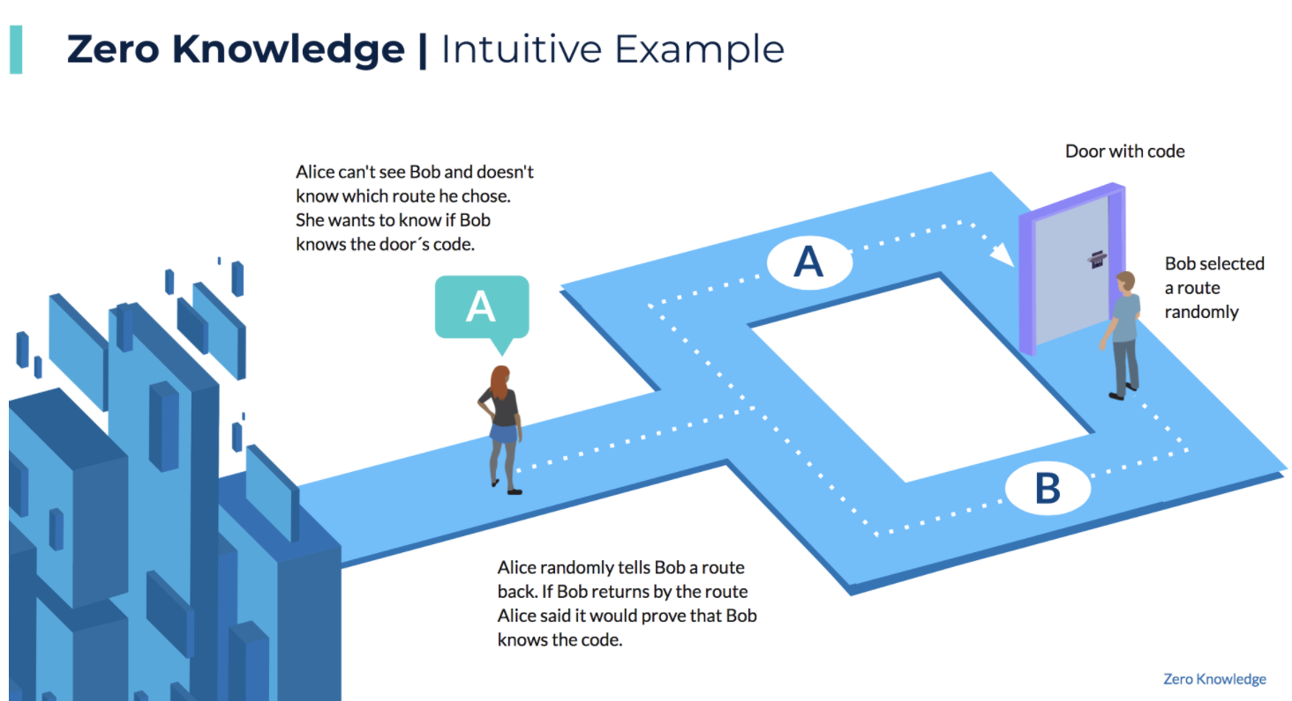
6 Zero-Knowledge Proof Technologies
Decentralised identity is evolving to include privacy-oriented mechanisms that reduce excessive information sharing, such as zero-knowledge proofs (ZKPs). This privacy-preserving mechanism uses messaging protocols that enable entities to prove that information available is correct, without the requirement to transmit or share the underlying information.
ZKPs has applicability in a wide range of verifiable claim exchange use cases, such as age, medical records and professional certifications. These use cases usually involve a verifier asking a question and the user providing an answer (without sharing the underlying information), with a cryptographic proof of answer correctness. The proof is constructed based on an attribute or credential that is usually issued by another organization. For example, users can confirm if they meet the age requirement without sharing their birthday.

Slide 21
7 Logical Architecture (draw up as a picture that expands on next slide)
Logical architecture major components and purpose of each element
Agents (cloud or edge) - Software that mediates communication between holders, issuers and verifiers
Trust over IP - Sovereign (guardianship) and Hyperledger
Trust fabric - explore options and alternatives to blockchain?
Decentrialised identity - explore the different types, schemes and methods
Digital wallets (Edge) - Everynym, Mattr, trinsic, can we use Google or Android wallets
Digital Wallet (Cloud) - Integrate into NHS App
Verifiable Credential (Standards for VC and decentrialised identity - W3C, is payload FHIR?)
OpenID Connect, OAuth 2.0 bridge between VC standards so we can use VC to auth/authz
Private credential store - Projections via Event Stores? Or personal data stores such as a POD
Personal data stores - PODs - alternatives? (Is this the private chain in Sovrin) Disclosure APIs?
Account - is this just a microservice? How do we integrate this into multiple services?

Slide 22




Issue/Certify Credentials
Verify
Credentials
Application
Wallet -
API -
Agent -
Payload - used to exchange data between identity owners based on an extensible schema (possible options to explore are JSON-LD, JWT, CWT)
Encoding - consider multiple options e.g. JSON, Protocol Buffers, Avro
SDK - Open source (consider Evernym, Mattr etc.)
James Brown
Master key (private)
Decentralised Identity Implementation
(Wallet, Agent, SDK, API, Payload, Encoding)
Derived key pairs
Data Protection & Authentication
Private
Public
Identifier
Private
Public
Identity Trust Fabric
Public identifiers
Signed Credentials
Digital Wallet App
Public keys, service endpoints, credential schemas, credential definitions
Identity Trust Fabric
(shared ledger)
DID Document

Slide 23
7.1 Example - Establishing an initial connection with a Hospital
Lisa wants to check in to an outpatient appointment at her local Hospital. The Hospital publishes its public DID on its website and allows patients to register their attendances by tapping an NFC terminal in the Hospital lobby. Lisa registers her attendance and establishes a secure channel of communication by tapping the NFC terminal or reading a QR Code.
Lisa’s digital wallet app recognises the NFC terminal as communicating a DID. It looks up the DID, and retrieves the current DID document. It verifies that the DID document is valid and signed by the holder of the DID. Within the DID document is the endpoint for the Hospital’s agent. Lisa’s wallet app then automatically creates a new private DID for Lisa’s relationship with her Hospital.
This private DID will have its own private DID document containing a new public verification key, plus the unique agent endpoint that she wants the Hospital to use.
Lisa’s wallet app then, through Lisa’s agent, contacts the Hospital’s agent endpoint, peer-to-peer with no intermediaries, and establishes a new connection using this private DID, DID document, and agent endpoint that are shared only with the Hospital. The Hospital reciprocates, giving Lisa back a private pairwise pseudonymous DID and DID document just for this new private relationship that Lisa can verify using the Hospital’s public DID and DID document.
The Hospital and Lisa now have a secure, private way of communicating whenever they need it. The Hospital can then use this channel to send Lisa specific details about their medical condition, including scan results and other medical observations. Lisa can verify this information using the private DID and DID document the Hospital supplied her with. The Hospital can do the same thing with Lisa’s private DID and DID document when she responds to the Hospital’s information.
Lisa and the Hospital use the trust fabric to find one another and then to negotiate a completely private channel that is unique to that particular relationship without needing an intermediary. They can then share verifiable credentials over this secure channel in order to establish the necessary level of trust to share health information.
This is like Lisa calling the hospital and the two of them instantly inventing a brand-new language together—that only Lisa and the Hospital know. If someone were to tap the line and listen, they wouldn’t understand a thing. In this example, the Trust fabric is only used for the lookup, discovery and verification of the Hospital’s public DID. Then each party establishes a private, pairwise pseudonymous DID with the other.
From that point on, all further communication and data exchange takes place off-ledger. This ensures both greater privacy and stronger security as neither party is reusing a public key that they have used with any other party. It’s also much more scalable because the trust fabric is only involved with the initial establishment of the relationship.
Adapted Example From ‘What goes on the ledger’ SOVRIN FOUNDATION WHITEPAPER

Slide 24
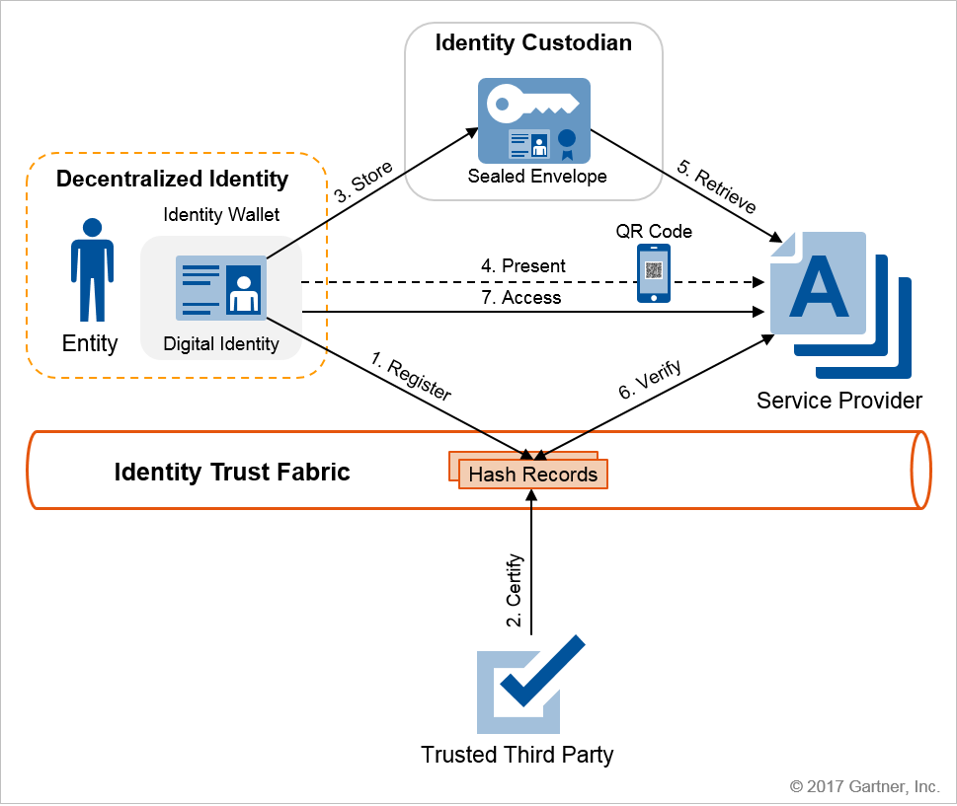
8 Decentralised Identity Flow)
Digital credentials can be stored in a digital wallet in the user’s mobile device (also called edge wallet). Alternatively, they can be stored in the cloud (thus called cloud wallet). When an Identity Custodians organisation stores the identity attributes (also known as claim or digital asset), the identity wallet stores the private key and reference address of a protected envelope, which is stored in an Identity Custodians environment in the cloud.
The protected envelope's content includes the identity information, and it is encrypted using a symmetric key (i.e. the private key) in the wallet before storage in the Identity Custodians environment. When the user presents their credentials at care settings to be verified, the care settings system uses the private key to decrypt the identity information.
The core functions in this model are extended with additional functions that include storage and retrieval of the identity envelope in/from the Identity Custodian cloud.

Slide 25
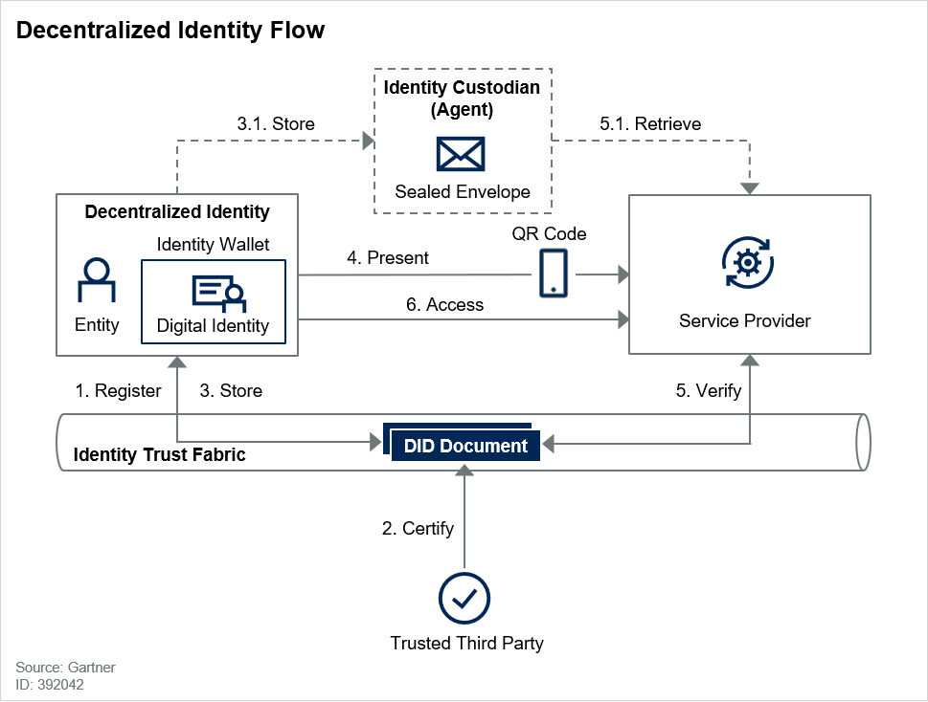
8.1 Registering
The user generates a core identifier with associated private and public key pairs in the identity wallet to interact with the ITF.
Subsequently, users generate a pairwise-unique identifier via their identity wallet for each relationship they have with other organisations (as needed).
The DID metadata, including public key, service endpoints and other related information, are included in a discoverable document and stored in the ITF.
Note that UI is leveraged here, in notifying the user of consent and relevant actions. This area must leverage privacy-by-design techniques to include a good privacy user experience (UX).

Slide 26
8.2 Certification
A trusted third party establishes a pairwise-unique identifier with the user. Then it validates the user identity as part of a proofing process using appropriate online or offline methods for the required assurance level.
The validation happens during the initial binding. After the positive validation of the identity information, the trusted third party certifies the core identity by issuing a signed credential.
A subsequent enrollment process at a service provider can be simplified using this credential. At the user’s request, other organisations can additionally certify identity records to enhance the assurance level (by implementing a progressive trust model).

Slide 27
8.3 Storing a credential in the Wallet
The signed credential is stored in the user wallet or an agent that acts as an identity custodian.
When an agent stores identity records (Step 3.1), the user wallet stores the private key and reference address of the protected envelope in the agent.
The protected envelope is encrypted using a symmetric key before storage in the agent wallet.

Slide 28
8.4 Presenting the Credential
Assuming a pairwise-unique identifier between the user and service provider exist, a claim (signed credential) is presented to the service provider.
The service provider uses a resolver service to locate the DID document in the ITF to verify the credential. This step includes other layers of authentication (for example, biometrics or multifactor authentication) for verification within the identity wallet to unlock the private key for signing data.
When using an agent, the user initially provides a reference to the encrypted envelope in the agent wallet for the service provider to retrieve the envelope.

Slide 29
8.5 Verifying the Credential
The service provider retrieves the DID document from the ITF and uses the public key and other attributes to verify the credential using appropriate authentication and authorization protocols.
When an agent stores the credentials (Step 5.1 in the figure), service providers must initially retrieve the encrypted envelope from the agent wallet to access DID documents for verifying the claim.

Slide 30
8.6 Accessing the digital service/Protected resource
After successful verification of the claim, the organisation grants access to the requested service/application
The organisation must audit the access request. The claim request must contain sufficient information to facilitate auditing requirements.

Slide 31
9 Lisa’s story
Lisa is 35 years of age and lives in a flat in Sheffield with her 7-year old Eddie
Unfortunately Eddie suffers from asthma which makes it necessary to have regular GP appointments. He takes medicine daily on a long-term basis to maintain control of his persistent asthma.
Due to personal circumstances, Lisa and Eddie moved flats a few times within the last few years, which meant having to register with a different GP everytime.
Lisa felt frustrated when she realised that each GP had a different process to allow her to access Eddie’s electronic record so she can manage her son’s care effectively. She had to undertake a different process, complete an application and provide proof of her parental responsibility for Eddie everytime
With digital verifiable credentials, this process will be standardised and done only once, and updated when/if the circumstances change
Lisa can receive a digital credential that binds to her NHS identity so she can prove who she is for the GP system
Lisa can also receive a credential to prove her parental responsibility for Eddie
With the combination of the two credentials, Lisa can access the GP system on Eddie’s behalf, view the information she is entitled to, book appointments or order repeat medications

Slide 32


Proxy Access Personas
Sean is a 27 year old new Dad. He is super excited to become a dad and is looking forward to play an active role in bringing up his newborn daughter Tia.
The Work time pattern and child care arrangements between Sean and his wife means that, quite often Sean would need to manage and book Tia’s check up and immunization appointments.
With the proxy user access feature, Tia’s mother has now added Sean as a legit user to access Tia’s records. With which, Sean can now perform all appointment management electronically, exactly as how Tia’s mother would be able to.
Helen is a 38 year old Nurse. Her dad David is 71 year and is diabetic. Because of David’s health condition, the blood sugar levels need to be checked and monitored twice a week. The arrangement with David’s GP is that the home blood check readings need to be entered into the system twice a week and based on the readings, dosage of the medication will be updated by the GP.
As Helen is a nurse, she does the home blood test for her dad, whenever she visits her dad. With Helen now having a proxy access to her Dad’s record, she is able to directly update the latest readings from the blood check. Helen is also able to check the latest dosage suggestions from the GP and advice her dad accordingly.

Slide 33

Proxy Access Personas (cont’d)
Mike is a 41 year old Solicitor. He lives with his 76 year old mother Michelle. Michelle was diagnosed with dementia for the first time when she was 68. The symptoms have gotten a bit worse in the last 3 years and therefore, Mike had drawn out a legal power of attorney to make decisions on behalf of his mother.
With the legal power of attorney and due to Michelle’s condition, Mike now has proxy access to his mother’s records and can make decisions on behalf of her.
Michelle had to undergo a knee surgery for which Mike consented to the surgery on behalf of his mother.

Slide 34








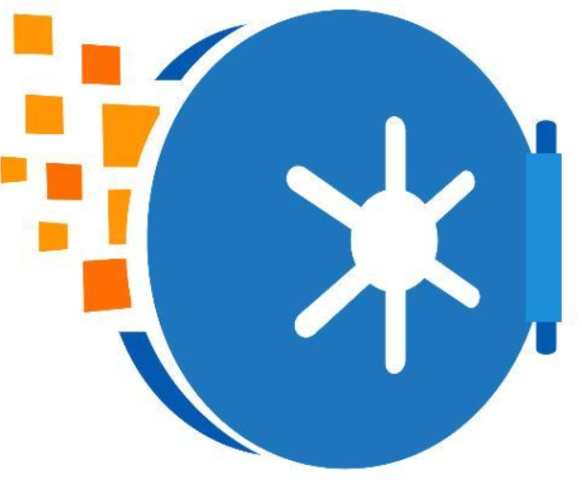


9.1 Lisa binds her NHS identity to a digital credential
Retrieve Lisa’s NHS number, DOB and names from PDS or use details held in Login
NHS Login establishes a trusted a pairwise-unique identifier with Lisa
Verify Lisa’s Identity (online or offline)
Signs the identity credential with the private key and issues it to Lisa’s DW
PDS
Name: Lisa
Role: Adult
Digital vault
Generates core identifier with with public and private keys and stores in DW
Install digital wallet (DW) in mobile device
Generates a pairwise-unique identifier for the identity relationship with NHS Login
Provides identity
documents/information
The signed credential and the private key are stored in Lisa’s DW. It can be stored in a sealed envelope encrypted with the private key in the cloud. The DW stores the reference address of the envelope in the cloud.
DID metadata, the public key (to verify NHS Login signature), service endpoints are included in a discoverable document and stored in the ITF
Identity trust fabric (ITF)

Slide 35



9.2 Lisa creates a parental access credential
GRO establishes a trusted pairwise-unique identifier with Lisa
Signs the parental access credential with the private key and issues it to certify parental responsibility relationship
Searches RON to verify mother-child relationship
Verifies Lisa’s identity credential
RON
Name: Lisa
Role: Birth
mother
Digital vault
Generates core identifier with with public and private keys and stores in DW
Name: Eddie
Role: child
Age: 7 years
Generates a pairwise-unique identifier for the relationship with GRO
The signed credential and the private key are stored in Lisa’s DW. It can be stored in a sealed envelope encrypted with the private key in the cloud. The DW stores the reference address of the envelope in the cloud.
DID metadata, the public key, GRO service endpoints are included in a discoverable document and stored in the ITF
Identity trust fabric (ITF)

Slide 36


9.3 Lisa uses her credentials to access Eddie’s GP record
Digital vault
Uses the public key read from the DID document to verify the credentials by using appropriate authentication and authorisation protocols
If the credentials were stored in an agent in the cloud, the GP system must retrieve and decrypt them first
Grants Lisa access to Eddie’s record
Uses resolver service to retrieve the DID document from the ITF
Records access and action details in audit trail
Clinical system
Name: Lisa
Role: Birth
mother
Uses her DW to present the signed credentials to the GP system
Name: Eddie
Role: child
Age: 7 years
Establishes pairwise-unique identifier with the GP system
Accesses record and complete task (book appointment, order medication, ...etc.)
If the credentials are stored in an agent in the cloud, this step presents the reference to retrieve the credentials
Identity trust fabric (ITF)

Slide 37
10 Further Notes
Step 3 (DID with IdC) — Store: The wallet creates an encrypted envelope that contains:
The reference address of the public key and the related credential hash records on the ITF
Other profile attributes and the reference addresses of their hash records
Their corresponding certification records on the ITF
The envelope's content is, first, signed using the wallet private key and then, encrypted with a symmetric key that is maintained on the wallet. The symmetric key can be simply a passcode. The encrypted envelope is then stored in the IdC environment for later retrieval. The wallet receives a reference to the envelope storage location (the envelope reference address) for future use. This reference address represents the decentralized identity.
Step 4 (DID with IdC) — Present: The wallet has to present the identity data for confirmation. At this point, the wallet may or may not have network connectivity. To confirm the identity, the wallet presents the identity data using mechanisms, such as generating a QR code that contains the following information:
The public key
The envelope reference address (which was received during the storage process)
The symmetric key that is needed to decrypt the secure envelope
The service provider receives the information via mechanisms such as scanning the QR code to capture the data.
Step 5 (DID with IdC) — Retrieve: The service provider uses the envelope reference address to retrieve the encrypted envelope from the IdC server. Once the envelope is received, the signature is checked by the public key, and then, the symmetric key is used to decrypt and retrieve the envelope's content. The envelope's content is employed to get the hash records of the public key, attributes and certifications from the ITF for verification.

Slide 38
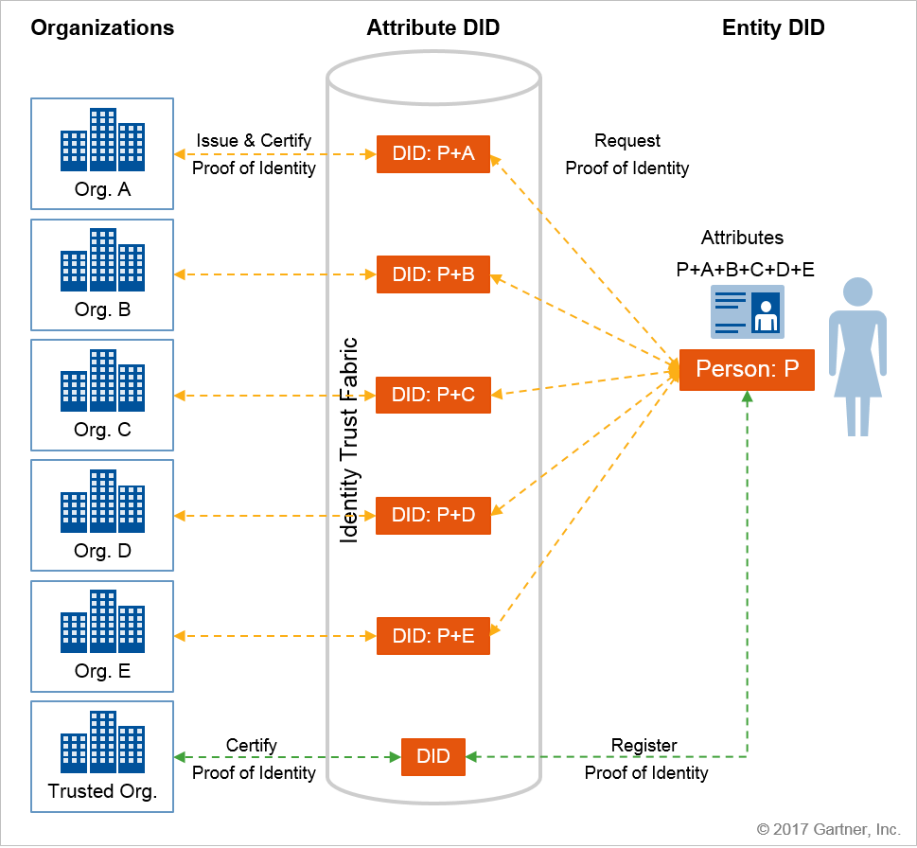
Storing Identity Profile Attributes in the Entity Wallet
In this model, the attributes remain in an identity wallet, which puts the user entities in charge of managing and sharing their information. In this approach, attributes are aggregated, protected and controlled by users in an identity wallet and related services (see Figure 5).
Some argue that this model is better from a privacy perspective as it can reduce the user information footprint in other organizations. However, it increases the administrative load on users that may need ancillary services to reduce the burden and enhance the user experience. Physical wallets (that include driver's license, bank cards, credit cards, health cards or other identification cards) are how people identify themselves in the real world.

Slide 39
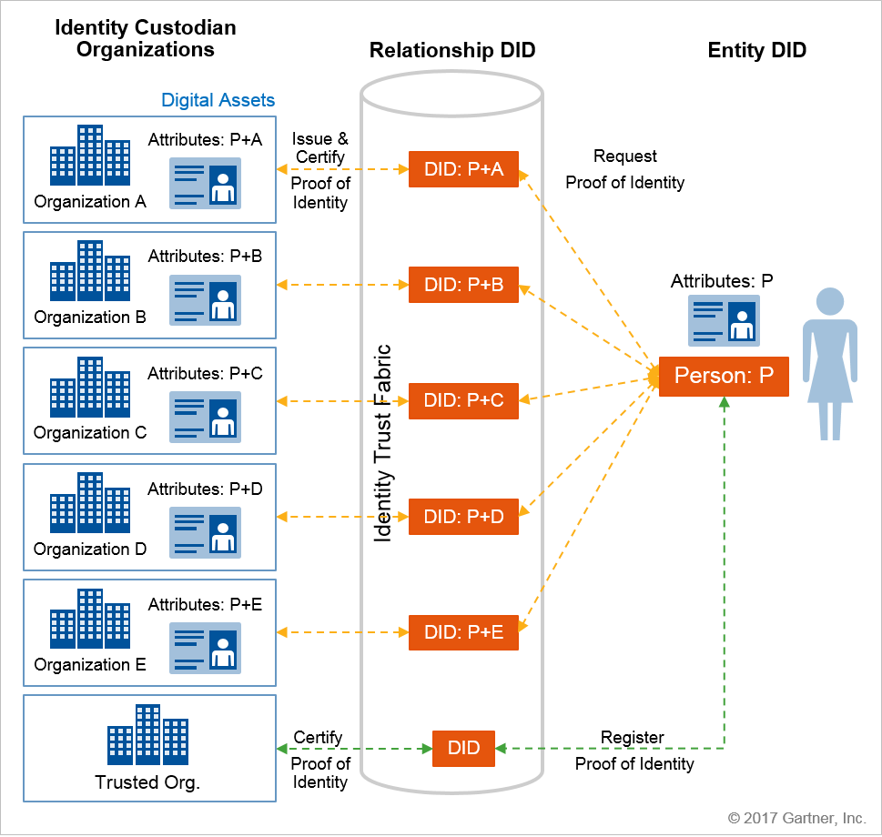
Storing Identity Profile Attributes in the Issuing Organization
In this model, the attributes remain in the issuing organization, which introduces elements of centralization in the system. In this approach, attributes are stored and protected (but not controlled) in each trusted organization where they originated (see Figure 6).
However, the user entities remain in charge of sharing their information beyond the host organization. This is good from the ease-of-adoption perspective as long as these organizations prevent data aggregation and correlation. That means the organizations have more responsibility to protect the data that they host on users' behalf.

Slide 40
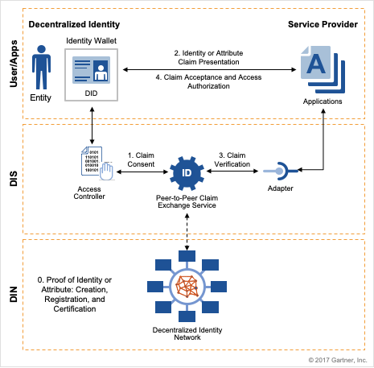
Decentralized Identity Service
A decentralized identity ecosystem needs DIS to expose identities and attributes in a DIN for the benefit of users and consuming applications
These services include:
Decentralized identity wallet: For user entities to establish and maintain DID, including required cryptographic key management capabilities and integration with DIN
Decentralized identity access controller: For users to manage consent as to which attributes should be shared with which organization in return for accessing their services
Decentralized identity claim exchange: For standard claim presentation and verification for users and applications/services to interact with DIN
Decentralized identity adapters: For applications to integrate with a claim exchange and interact with DIN to consume decentralized identity and related attributes

Slide 41
The Enterprise Architecture principles
Commission as Platforms/Products over Projects
Commissioning the standing up of Platforms and Products will ensure the needs of the consumers are met over the lifecycle rather than just the initial period
Reuse over buy, buy over build
Business applications, system components and data will be reused wherever possible, purchased as SaaS solutions if necessary and only built if there is a unique requirement that cannot otherwise be fulfilled.
Design for composability
We architect to provide ecosystem aware components that can be selected and rapidly assembled in various combinations to satisfy specific user requirements.
Automate
Automation increases time for increased time for value-add work and as a byproduct removes human error, reduces wait times, and increases prevalence of high-quality data.
Be Agile, Learn from Mistakes
Execute proof of concepts and Value before making investments. Address Risks early, When things don’t work, learn and adapt quickly
Capture and Act on Insights
The Digital ecosystem requires rich and complete data sets to improve data-driven decision making, business intelligence and to enable automation and AI.
Design Data to be used as a National asset
The free exchange of useful data for the benefit of all involved, in particular to patients and families who must be both co-creators and prime beneficiaries no matter where in the country they live or receive care.
Secure and Compliant by Design
We must meet our compliance and regulatory obligations, whilst providing a safe and secure environment to maintain trust and availability of services.
Challenge outdated policy, Enforce where present and correct.
Empower communities of interest to champion or challenge outdated policies so that we can reflect and improve them and drive the right types of behaviour from the grassroots
Cloud and Internet first
Making our services available on Cloud and Internet, provide access to services from any location, enables Digital development in the Healthcare Marketplace, and provides focus by reducing distractions from running our own hosting infrastructure.

Slide 42
11 Stakeholders
Area | Stakeholders | Comments
Login | Melissa Ruscoe, Phil Nixon and Becky Smith | All NHS Digital
The App | Darren Hutton (Product Owner, Digital Services Delivery, NHSD)
NHS.UK | Harriet Messenger (Head of Product, NHS.UK, NHSD), Rob Bridgewater ( Lead Product Manager, NHSD, NHS.UK), Kieran Brough (Technical Architect, NHSD)
Wellness and Prevention | Greg Wright, Alastair Allen, Peter van der Merwe | All Kainos
NHSX Identity | Carlos Trigoso | NHSX CTO
Platforms | Stephen Koch (NHSD), Jill Sharples (Head of Product and Delivery for NHS Digital Platforms), John Heaton (Lead Designer Digital Services Delivery, Platforms and Infrastructure Directorate, NHSD), Richard McStay (Lead Delivery Manager, Digital Services Delivery Platforms and Infrastructure Directorate, NHSD) and Shan Rahulan (NHSX CTO)
Child Health and Maternity | Kristen Allin, Neil Calland, Andy Payne | NHSX Mission 2
GP Connect | Dilraj Bhatia (NHSD) and Ramsey Baker (NHSD)
Mental Health | Hilary Tovey (NHE) | Maternity relating to perinatal mental health policy

Slide 43
12 Glossary of Terms
Application ecosystem
Claim:
Credential subject: The entity (in this case, a decentralized identity) about whom a claim is issued. The subject key functions are to store, retrieve, move and assert claims.
Credential issuer: The entity (typically an authority) that creates a claim and associates it with a subject. The issuer’s key functions are to issue, assert, revoke or amend credentials.
Credential verifier: The entity (typically a service provider) that verifies a claim about a given subject. The verifying entity must have the capability to connect the issuer’s identity to its credential identifier and the subject’s identity to its identifier as indicated in the credential. The issuer’s verification information, such as its public key, must be discoverable from the credential record and verifiably linked to the issuer.
Credential holder: A role an entity may perform by possessing one or more verifiable credentials. In the case of decentralized identity, a holder is usually (not always) the subject (controller) of the verifiable credentials that it is holding. Holder may be an agent of the subject. Holders store their credentials in credential repositories. In a decentralized identity, verified credentials can be stored directly in the user wallet (or in the holder [agent/custodian] wallet). The holder of a verifiable credential should be able to restrict the amount of information exposed in a credential it chooses to share and limit the duration for which that information is shared
DID: Decentralised IDentity.
DID document:
DID metadata:
Digital wallet (DW): A software module, and optionally an associated hardware module, for securely storing and accessing private keys, master secrets, and other sensitive cryptographic key material and optionally other private data used by an entity. A Wallet may be either an Edge Wallet or a Cloud Wallet. In Sovrin infrastructure, a Wallet implements the emerging DKMS standards for interoperable decentralized cryptographic key management.
ITF: Identity trust fabric.
Meta data:
Pairwise-unique identifier: A Pseudonym used in the context of only one digital relationship (Connection)
Utility:

Slide 44
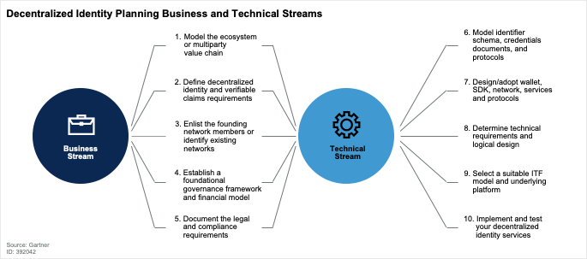
Appendix A - Planning Business and Technical Streams

Slide 45
Appendix B - Further Considerations
New technology: Decentralised identity solutions and underlying blockchain (or distributed ledger) platforms are mostly new and immature. These solutions rely on technologies that are fluid, such as distributed consensus algorithms, which require further design and implementation. Lack of understanding of blockchain technologies and available skills may cause adoption challenges. In addition, because of the lack of standards, vendors resolve blockchain-related issues (such as performance or key management) using proprietary approaches. This may cause future integration and interoperability problems (such as handling multiple identifier schemes and claim exchange protocols).
Governance framework, financial model and adoption complexity: Decentralized identity success is highly dependent on establishing an ecosystem or marketplace of participating entities (identity owners, identity network operators and identity consumers). These entities must sign up and agree to trust policies and adapt their usage and services to required processes. In addition, for the ecosystem to sustain its existence in the long term, there must be a practical financial and incentive model that encourages all participants. These factors, in addition to challenges with sales and marketing in a three-sided market (that is, identity owner, consumers and services), add to the complexity and timeline that vendors require to develop and offer their services.
Key recovery: what happens if the user loses his/her wallet (as a result of losing their mobile device)
Need to consider all scenarios of how proxies interact with care setting systems on behalf of patients. For example, the scenario when telephoning the care provider to book appointments, order prescriptions, ...etc.

Slide 46
Issuing and verifying digital verifiable credentials for (identity and parenthood)
Issuing
Signs parenthood credential with private key
Verification
James Brown
RON
Pairwise unique identifier for relationship
Master key private
Register Online
Uses public keys to verify credentials
Derived key pairs
Private
Public
Signs identity credential with private key
Private
Clinical system
Public
Pairwise unique identifier for relationship
Signed Credentials
PDS
Digital Wallet App
Pairwise unique identifier for relationship
Retrieve public key and DID document
NHS Login Public Key
GRO Public Key
Identity trust fabric (ITF)

